Slide 1

Coffee Shop sales Analysis
Brewing Insights and Trends

Slide 2


Introduction
Objective:
Providing an overview of the coffee shop's sales performance across different products and periods.
Identifying key insights that will help improve operations, inventory management, and marketing strategies.

Slide 3
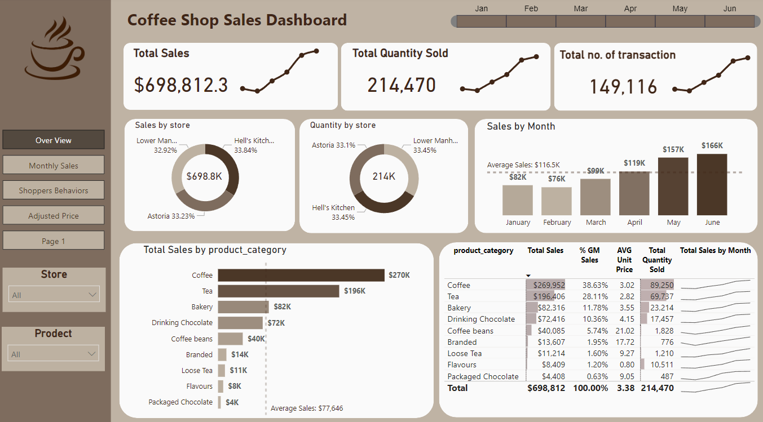
Our dashboard
Overview

Slide 4
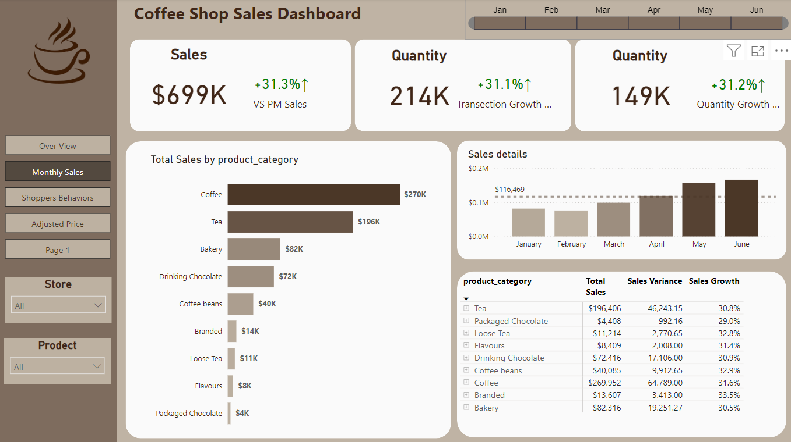
Our dashboard
Monthly Sales

Slide 5
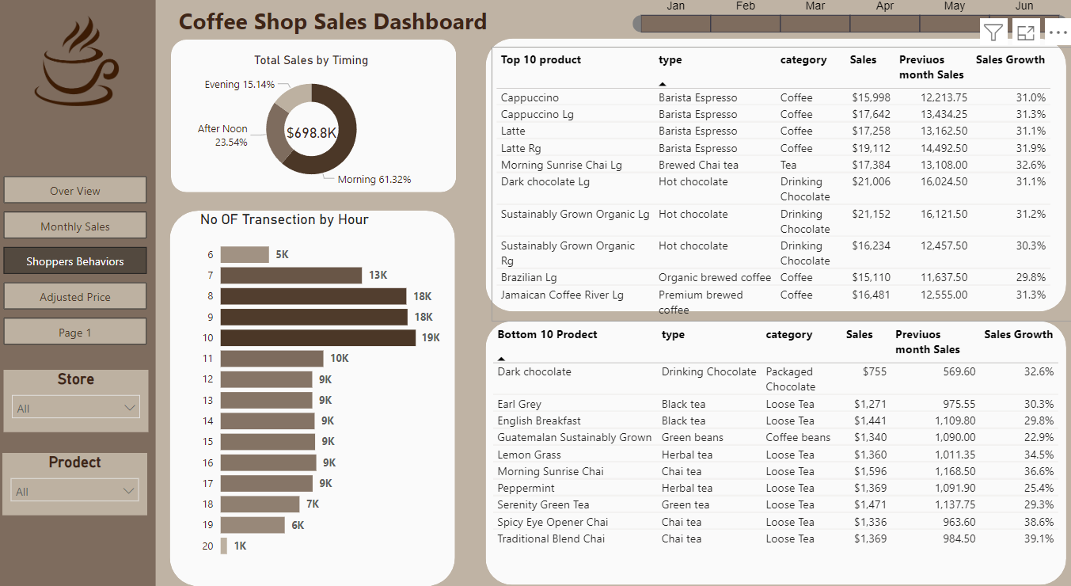
Our dashboard
Customer bahavior

Slide 6
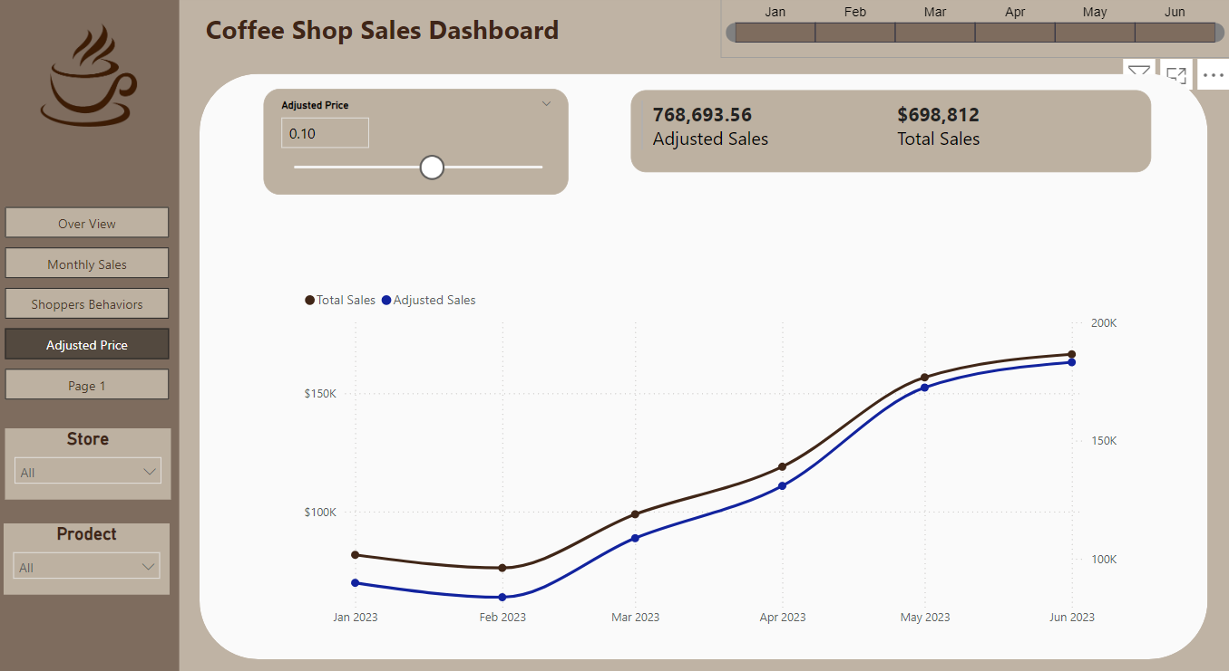
Our dashboard
Adjusted price impact

Slide 7
Recommendations
Stock More High-Selling Productss.
Promote Low-Selling Categories
Focus on keeping high-demand products like espresso-based drinks and coffee beans well-stocked during peak hours.
Targeted promotions for products like packaged chocolates and branded items could help improve their sales.
Optimize Staffing for Peak Times
Product Diversification
Given that mornings are the busiest, staffing could be adjusted to ensure fast service and maximize customer satisfaction.
Introduce more variations or premium offerings in the tea and bakery categories to expand the menu and attract different customer segments.

Slide 8


